Slide 1
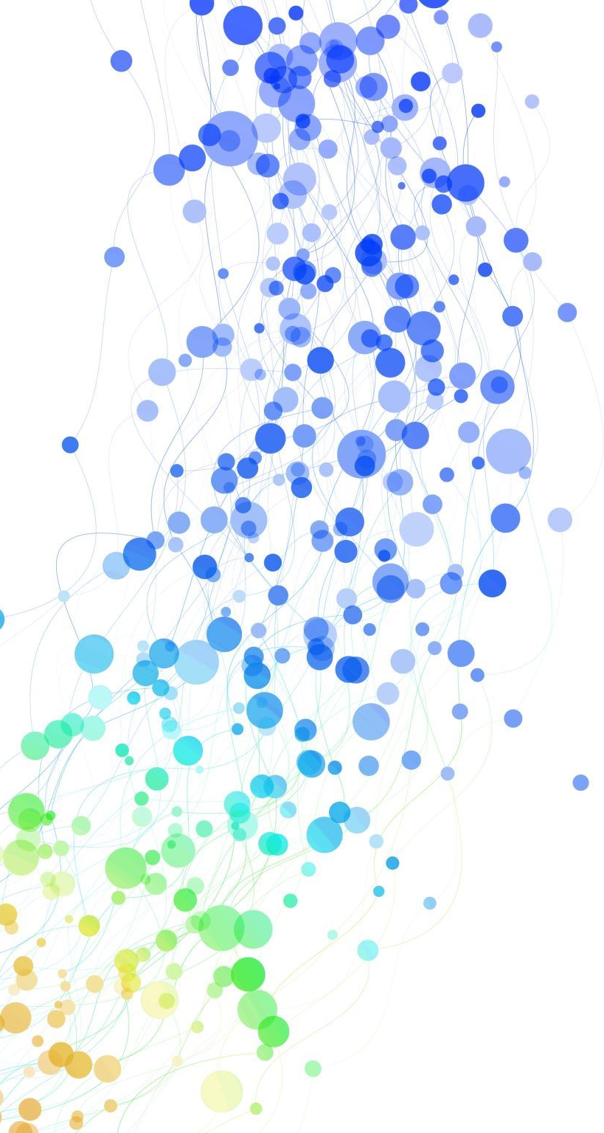
The Robustness of Watermark Embeddedness Based on Different Transformations with Different Algorithms into Different Fre

Slide 2
Introduce
identify the source of some image
claim the copyright of it

Slide 3
Blind---\--->Invisible
the original picture is not necessary for extracting the watermark from the embedded picture.

Slide 4
Four Watermark Embedding Method
WATERMARK SORT | TRANSFORM | FREQUENCY | ALGORITHM
Reference | 3-level wavelet transform with Daubechies-8 filters | high | quantized
Low Frequency | 3-level wavelet transform with Daubechies-8 filters | low | quantized
Fourier | Fourier | high | quantized
Additive | 3-level wavelet transform with Daubechies-8 filters | high | additive

Slide 5
Attack
Blurring
Sharpening
Rotate
Cropping
Compress
Salt and Pepper

Slide 6

Method

Slide 7
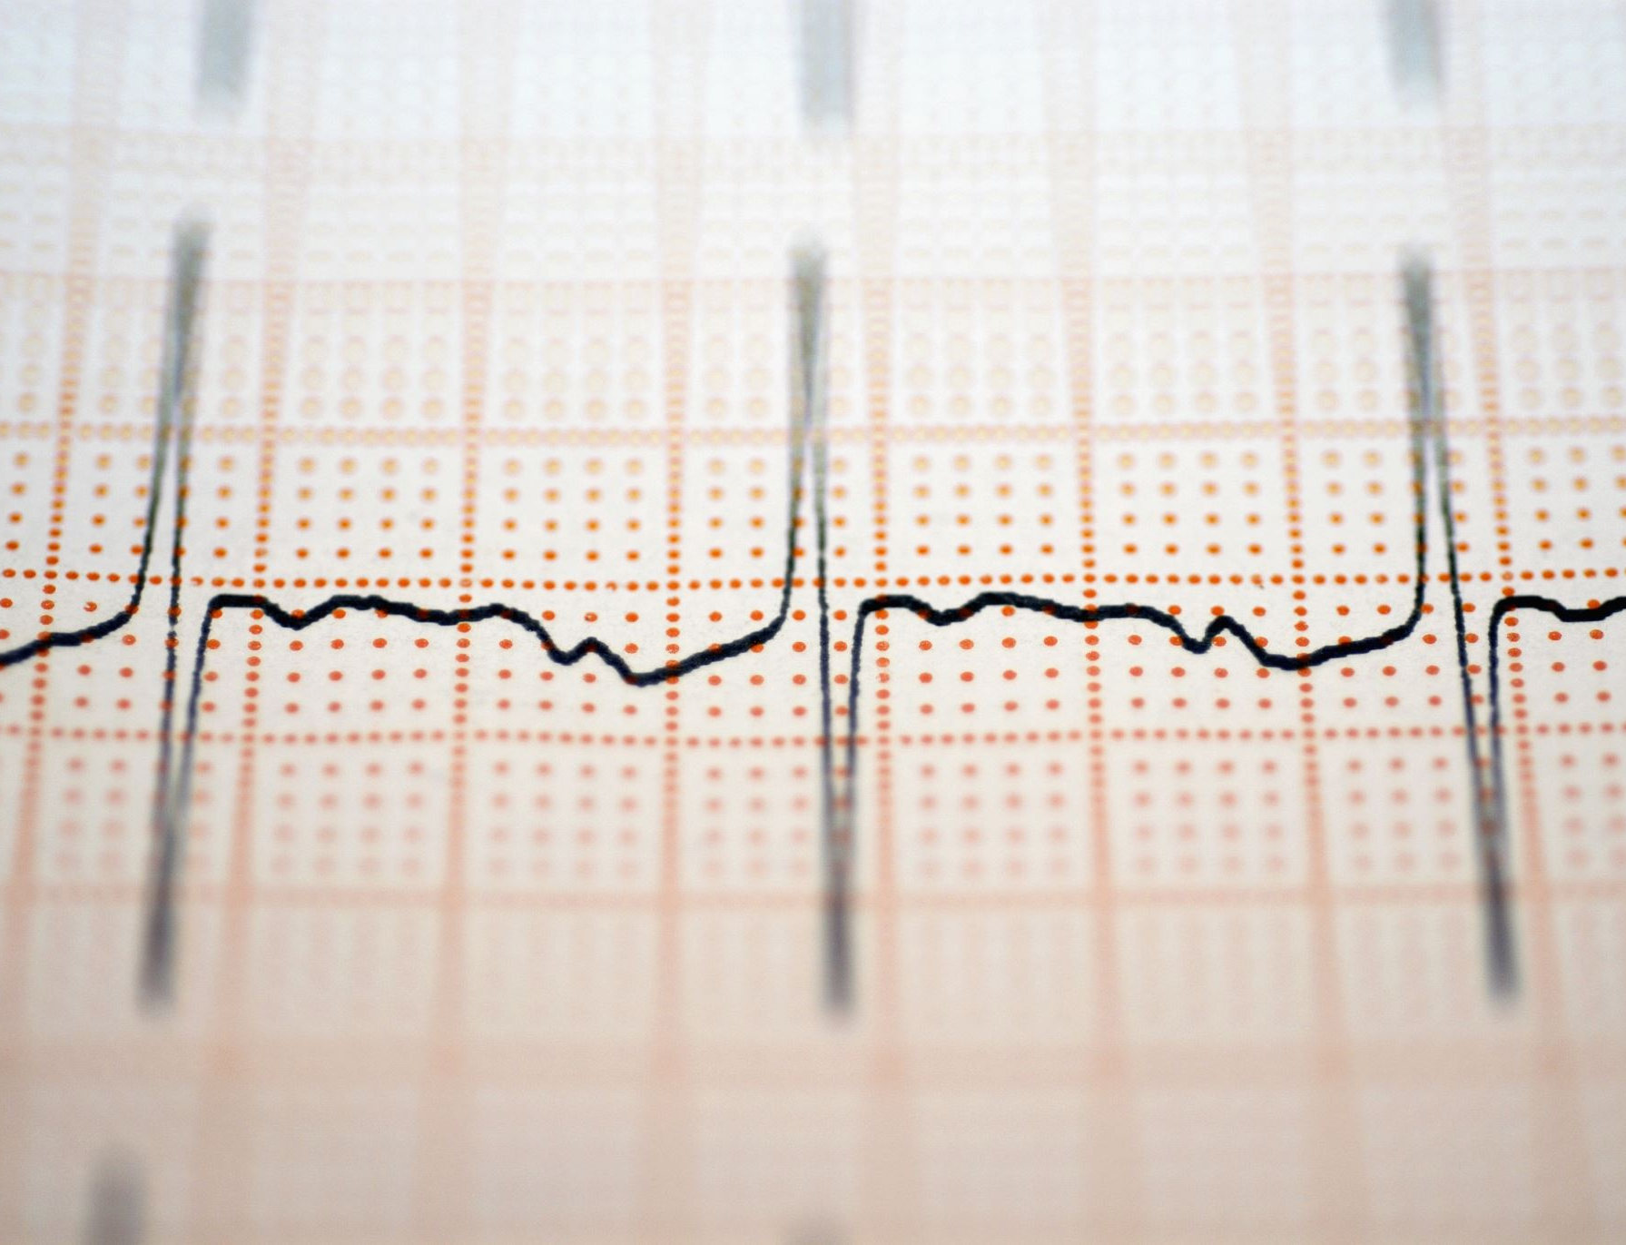
Transform
Wavelet Transform
Fourier Transform

Slide 8
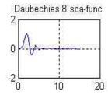
Wavelet Transform
Daubechies-8 filter
3 levels

Slide 9
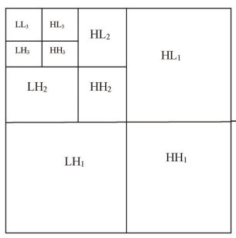

Slide 10
Fourier Transform
imageAftDft=cv2.dft(np.float32(image), flags = cv2.DFT_REAL_OUTPUT)
The low-frequency band is not shifted to the center, gain the middle square to get the high-frequency band.

Slide 11
Algorithm
Quantized algorithm
Additive algorithm(Dugad’s method)

Slide 12
Quantized algorithm
Embedding
Detection

Slide 13
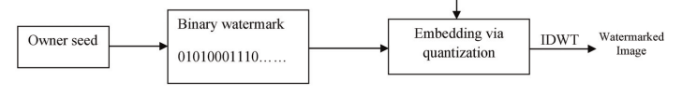
Embedding

Slide 14
Generate wateramark
Boolean
The same size as embedded band
A certain seed

Slide 15
Select satisfied coefficients
higher than t1 and lower than t2
t
0.01< α<0.1 and t2>t1>t

Slide 16
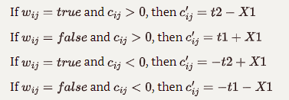
Embedding
Cij: the coefficient satisfying the condition
Wij: the watermark value at the corresponding position
C'ij: the coefficient after quantization
X1: a value narrowing the range between the two quantization

Slide 17

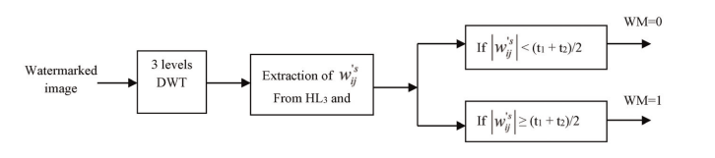
Detection

Slide 18
Select satisfied coefficients
higher than or equal to t1 + X2 and less than or equal to t2 – X2
the value of X2 should be lower than the value of X1

Slide 19

Extraction
W'ij :is the watermark detected at the corresponding position.

Slide 20
comparison
Difflib.SequenceMatcher()

Slide 21
Additive algorithm (Dugad’s method)
Embedding
Detection

Slide 22

Embedding
Wij is the coeffient with value higher than t1
Xij is the watermark:
fits the standard normal distribution
a known seed value
equal in size to the input image

Slide 23

Detection
V*i is the coefficient of magnitude greater than t2:
t2 is greater than t1
Wi: the watermark values at the same locations.
N: number of the satisfied coefficients

Slide 24
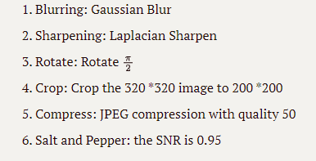
Attacks

Slide 25
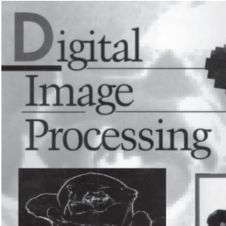
Results

Slide 26
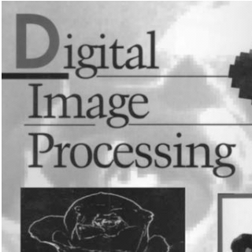



Invisibility
Fourier
Reference
Additive
LowFrequecny

Slide 27

Data
D: the value measuring the degeneration of the watermark
Rbase: the similarity ratio of detecting the watermark instantly after embedding the watermark
Rbefore: the similarity ratio of detecting the watermark before embedding
Rattacki: the similarity ratio of detecting the watermark under attack i

Slide 28
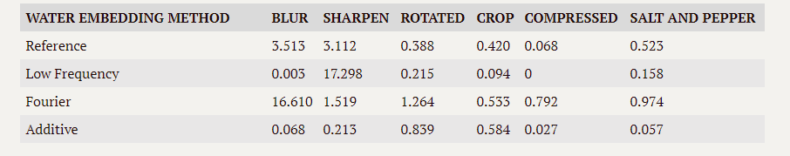
Data Recording

Slide 29
Discussion
the robustness of Low Frequency and Additive is better than the Reference, especially the Low Frequency
But the watermark embedded in low-pass bands of the wavelet domain affects the fidelity of the watermarked image
the watermark embedded in low-pass bands of the wavelet domain
the watermark in high-pass bands is resistant to another set of attacks such as histogram equalization, intensity adjustment, and gamma correction
it seems that the Fourier transform is more suitable to collocate with the additive algorithm

Slide 30
Reference
Abeer D. Algarni and Hanaa A. Abdallah. Blind Wavelet-Based Image Watermarking
https://zhuanlan.zhihu.com/p/379228103
https://blog.csdn.net/wsp_1138886114/article/details/116780542
https://pywavelets.readthedocs.io/en/latest/ref/index.html
https://github.com/guofei9987/blind_watermark

